Slide 1



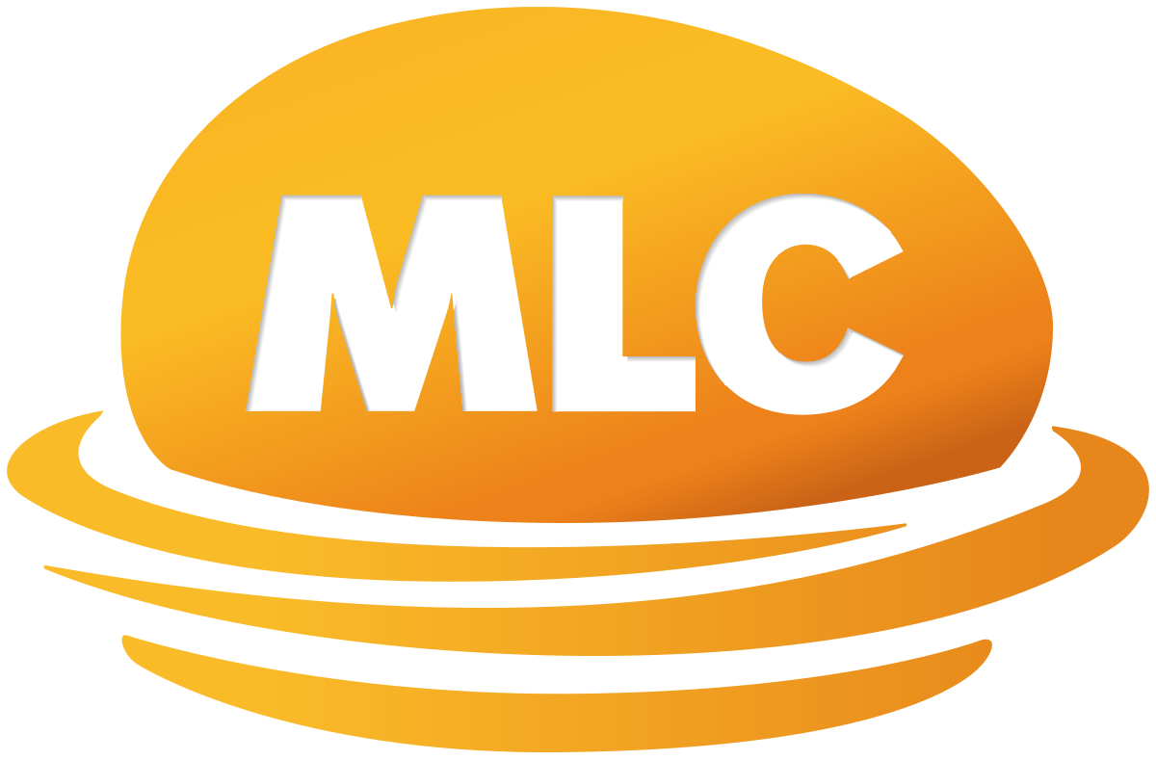
www.intelia.ai
Case Study – DataOps Creating “Speed to Insights”
Data Consulting
Business stakeholder engagement and consultation
Current state analysis
Strategy, solution and capability uplift recommendations
DataOps
Data Governance
Problem
Solution
Having recently successfully implemented Snowflake as a modern cloud-based data platform (the “EDW”), MLC’s Data Analytics Team wanted to level up their overall efficiency and effectiveness in making data readily available for consumers to leverage data to produce analytics and insights.
They self-identified a number of areas that could be improved including priorities, decision-making ownership, process clarity and consistency, architecture & design, resource constraints and collaboration.
The opportunity MLC saw was to introduce DataOps into their ways of working.
intelia’s comprehensive current state review identified a number of key feedback themes across Snowflake’s native capabilities, agile processes / operating model, data modelling and toil.
intelia then proposed 9 fully fleshed out recommendations to enable introduction of DataOps against the following target areas:
Processes (front door, operating model, agile approach)
Technology (focus on building business consumption layer, simplifying data modelling and relentless elimination of toil)
Team (re-organise to eliminate silos, clarify roles & responsibilities, upskill & introduce missing capabilities where needed)
Ways of Working (service-oriented culture, business value first, improved collaboration, relentless focus on “speed to insights”, improved outwards communication)
intelia’s Approach
As a key data partner, intelia were engaged to review the current operating model, engagement and delivery processes targeting Snowflake, Informatica Intelligent Cloud Services (IICS) and Microsoft Power BI technologies.
In particular, intelia were requested to explore opportunities to implement a DataOps model to increase speed to providing insights (reduce manual / duplicated effort, eliminate re-work & multiple hand offs etc).
Over a three-week period, intelia conducted extensive interviews with senior stakeholders to understand current state, pain points, challenges and opportunities which then enabled creation of the DataOps Recommendations Paper.
Outcome
MLC
For over 125 years, MLC have been helping Australians invest and grow their wealth, save for retirement, and protect their financial futures through insurance and expert advice.
MLC were able to directly leverage the DataOps Recommendations Paper to undertake their DataOps transformation journey to more effectively leverage their new Snowflake environment to:
Accelerate delivery of data solutions and make high value business data more readily available to data users for creation of insights
Automate previously heavily manual processes, create re-usable and standardised data products, and leverage CI/CD for continuous iterative releases
Improve data quality and increase business trust in the EDW
Improve business collaboration and speed to deliver new data solutions
We knew we needed the kind of experience and expertise intelia has in the DataOps space, they’re proven and highly respected by our team.
- Head of Data & Analytics
With offices in Melbourne and Sydney, intelia is a technology consultancy specializing in all things data (strategy, architecture, governance, analytics, modern cloud data platforms and intelligent automation)

